Slide 1
Managing project and Teams
Lecture 6: Managing Project Scope, Quality and responsibility

Slide 2
Retrospection
Defining estimates
Distinguishing estimation from planning
Listed the potential variation in projects
Identified benefits of accurate estimates
Discussed the factors to consider for estimation techniques
Notes:
After studying this chapter, students should know how to:
Develop relationships with customers and partners
Decide whether to prepare a proposal in response to a customer’s RFP
Create a credible proposal
Determine a fair and reasonable price for a proposal
Discuss how customers evaluate proposals
Explain types of contracts and various terms and conditions
Measure the success of proposal efforts

Slide 3
Key topics covered in this lecture

Slide 4
What we will cover in this lecture
By the end of the lesson, students should be able to:
Define project scope.
Identify project scope management steps
List the project schedule management
Identify four elements of quality management

Slide 5
What is project scope?
The project scope is the total amount of work that needs to be done to complete a project.
The process of tracking the scope of a project once it starts to ensure it doesn’t grow beyond control is known as scope management.
The scope of the project is central, as can be seen by its position in the middle of the project manager’s ‘trilemma’.
Notes:
If project changes during the project execution phase, the project plan, schedule and budget that were initially defined won’t match the scope, causing project delays and overspending.

Slide 6
Project Scope Management Steps
Plan and write the project scope
Collect requirements
Create a scope management plan
Define a scope baseline to control the scope and create WBS
Validate and control scope
Notes:
Defining the scope of a project consists of identifying the work that’ll be performed. Use a work breakdown structure to visualise the tasks required to create the project.
A scope baseline describes the project scope that was approved by both the project stakeholders and the project management team.
Monitor and Control your Project Scope During the Project Life Cycle
Validate Scope— The process of formalizing acceptance of the completed project deliverables.
Control Scope— The process of monitoring the status of the project and product scope and managing changes to the scope baseline.

Slide 7
PLAN SCOPE MANAGEMENT
This involves creating a scope management plan that documents how the project and product scope will be defined, validated, and controlled.
Plan scope management provides guidance and direction on how scope will be managed throughout the project.
Inputs
Project charter
Project Management Plan
Enterprise Environmental Factors
Tools and Techniques
Expert judgement
Data Analysis
Meeting
Outputs
Scope Management plan
Requirements management plan
Notes:
The enterprise environmental factors that can influence the Plan Scope Management process include but are not limited to: Organization’s culture, Infrastructure, Personnel administration, and Marketplace conditions.
The components of a scope management plan include:
Process for preparing a project scope statement;
Process that enables the creation of the WBS from the detailed project scope statement;
Process that establishes how the scope baseline will be approved and maintained;
Process that specifies how formal acceptance of the completed project deliverables will be obtained.

Slide 8
Collect Requirements
Collect Requirements is the process of determining, documenting, and managing stakeholder needs and requirements to meet objectives.
The key benefit of this process is that it provides the basis for defining the product scope and project scope.
Stakeholder register, assumption register, lessons learnt register, agreements are key inputs documents
Expert judgment, data gathering, and analysis techniques, decision making (voting) and data representation are key tools and techniques.
Outputs- requirements documents and requirements traceability matrix documents are key outputs at this stage.
Notes:
Requirements can be classified as:
Business requirements –the describe higher level needs of the organisation
Stakeholder requirements- describe needs of stakeholders
Solution requirements- these describe features that will meet business and stakeholder requirements. Solution requirements can further categorised into functional and non-functional requirements.
Functional requirements. Functional requirements describe the behaviours of the product. Examples include actions, processes, data, and interactions that the product should execute.
Non-functional requirements supplement functional requirements and describe the environmental conditions or qualities required for the product to be effective. Examples include reliability, security, performance etc.

Slide 9
Define Scope
Define Scope is the process of developing a detailed description of the project and product.
The key benefit of this process is that it describes the product, service, or result boundaries and acceptance criteria.
Existing risks, assumptions, and constraints are analysed for completeness and added or updated as necessary.
Existing risks, assumptions, and constraints are analysed for completeness and added or updated as necessary.
The Define Scope process can be highly iterative.
Creating WBS involves subdividing project deliverables and project work into smaller, more manageable components.
Notes:
Creating WBS involves subdividing project deliverables and project work into smaller, more manageable components.

Slide 10
Validate scope
Validate Scope is the process of formalizing acceptance of the completed project deliverables.
Validating Scope brings objectivity to the acceptance process and increases the probability of final product, service, or result acceptance by validating each deliverable.
Key outputs include accepted deliverables, work performance information, change requests.
Notes:
Validating Scope brings objectivity to the acceptance process and increases the probability of final product, service, or result acceptance by validating each deliverable.

Slide 11
Control Scope
Control Scope is the process of monitoring the status of the project and product scope and managing changes to the scope baseline.
The key benefit of this process is that the scope baseline is maintained throughout the project. This process is performed throughout the project.

Slide 12
Project Schedule Management
Project Schedule Management includes the processes required to manage the timely completion of the project.
Processes:
Plan schedule management
Define Activities
Sequence Activities [PERT, Critical Path Method]
Estimate Activity duration
Develop schedule
Controls schedule
Notes:
Plan Schedule Management — The process of establishing the policies, procedures, and documentation for controlling the project schedule.
Define Activities — The process of identifying and documenting the specific actions to be performed to produce the project deliverables.
Sequence Activities is the process of identifying and documenting relationships among the project activities.
A network diagram defines the sequence of how the activities will get done. It is a tool for arranging the specific activities in the best sequence and defining their dependent relationships.
The three most common techniques of network diagramming are program evaluation and review technique (PERT), the critical path method (CPM), and the precedence diagramming method (PDM).
Project Laddering is a project schedule compression technique where activities that are normally performed sequentially (one after the other) get performed in parallel for a portion of the actitivy.
Control Schedule — The process of monitoring the status of the project to update the project schedule and manage changes to the schedule baseline.

Slide 13
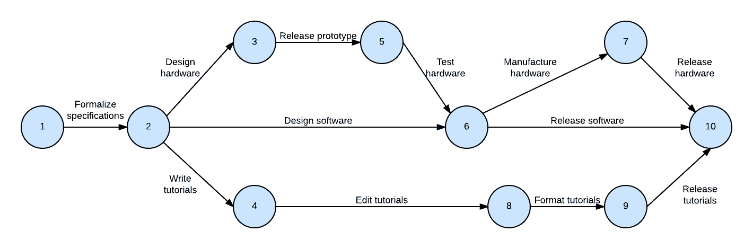
Program Evaluation and Review Technique (PERT)
Program Evaluation and Review Technique (PERT) is a project management methodology that visually represents the time it takes to complete a project.
Notes:
There are three types of time estimates used for estimating project duration: Optimistic Time (O), Most Likely Time (M) and Pessimistic Time (P).

Slide 14
Calculating The Expected
The PERT formula is used to calculate the expected time (TE) for each activity:
TE= (O + 4M + P)/6
O = Optimistic time estimate
M = Most likely time estimate
P = Pessimistic time estimate

Slide 15
Task
Assume you are part of a development team to create a mobile app. Use the following figures to calculate the expected Design UI/UX days assuming the following time estimates:
Optimistic time estimate (O): 5 days
Pessimistic time estimate (P): 15 days
Most likely time estimate (M): 8 days

Slide 16
Advantages of PERT
Time Management
Resource Allocation
Risk Assessment and Management

Slide 17
Disadvantages of PERT Charts
PERT is time-consuming and labour-intensive process.
PERT relies heavily on time estimates.
PERT lacks flexibility especially when the requirements change.

Slide 18
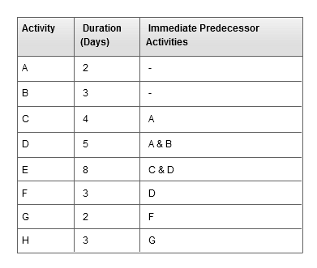
Class Exercise: Draw a Network Diagram
Use the following information to draw a network diagram.
Notes:
The network diagram is also is a communication tool for the project team because it shows who is responsible for each activity and how each person’s work fits into the overall project.

Slide 19
Plan for quality?
Planning for quality is a necessary, yet often forgotten or dismissed, function on a project. It is essential to have a plan for assuring the quality of project deliverables and results, rather than waiting until the end of the project to check if the sponsor/customer requirements and expectations on project deliverables have been met.
It is important to plan for quality in performing the project. This helps assure that the work is done according to specifications and applicable standards and that deliverables meet acceptance criteria.
Notes:
If project changes during the project execution phase, the project plan, schedule and budget that were initially defined won’t match the scope, causing project delays and overspending.

Slide 20
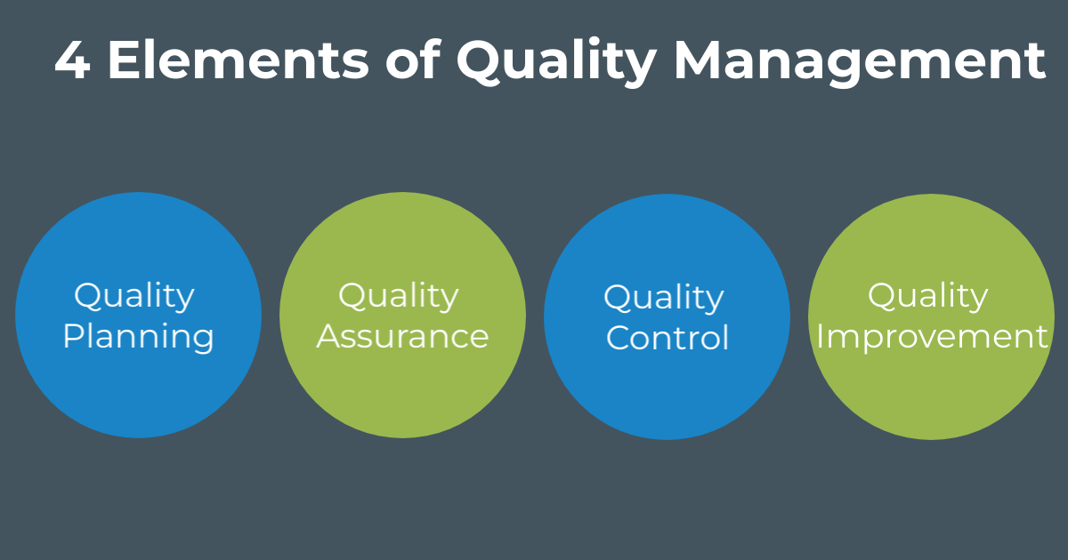
Notes:
Quality planning is the process for determining which quality standards are applicable to the project and how to apply them.
Quality assurance is needed to evaluate the overall project performance on a periodic basis to provide confidence that the process is effective and that objectives will be met.
Quality control is the ongoing effort to keep standards high.
Quality Improvement – is the culture and systematic approach to improvement that needs to be created to ensure that lessons are learned and that the root causes of problems are identified

Slide 21
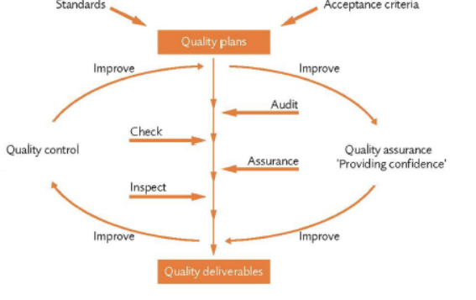
Elements of Quality Management

Slide 22
Summary

Slide 23
Key takeaway points
Define project scope.
Identify project scope management steps
List the project schedule management
Identify four elements of quality management

Slide 24
References
Starting Out in Project Management, Association for Project Management, (2018). ProQuest Ebook Central, http://ebookcentral.proquest.com/lib/ucsl/detail.action?docID=6348574. Created from ucsl on 2024-02-01 14:14:12.
Guide, P.M.B.O.K., (2017). A Guide to the Project Management Body of Knowledge (PMBOK® Guide), Project Management Institute.

